Slide 1


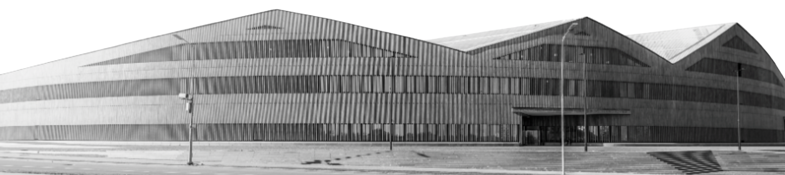
Stochastic Optimization with Heavy-Tailed Noise via Accelerated Gradient Clipping
Boris Mikheev
Petr Sychev
Notes:
Цель: показать, что использование self supervised подходов позволяет получить представления лучше для трансфера https://youtu.be/aU9yEwgrJ54

Slide 2
Structure
Problem Statement
Motivational Example
Assumptions
SGD with Clipping
Clipping SSTM
Main result
Discussion
Implementation
Reproduction
Experiments
Key results
Team Members

Slide 3
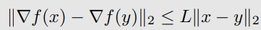
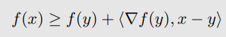
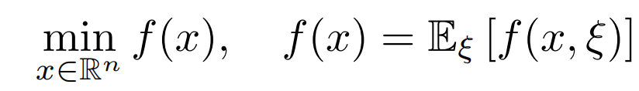
Problem Statement
Simplest solution - SGD

Slide 4
Motivational
Example
Simplest solution - SGD

Slide 5
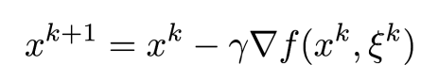
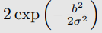
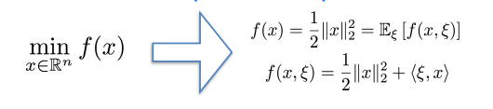
Motivational
Example
Stochastic gradient descent (SGD)
Definition 1.1 (light-tailed random vector). We say that random vector η has a light-tailed distribution, i.e. satisfies “light-tails” assumption, if there exist and
for all b > 0
Stochastic optimization problem
Notes:
Чем она отличается от других задач?

Slide 6
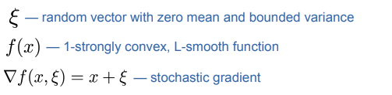
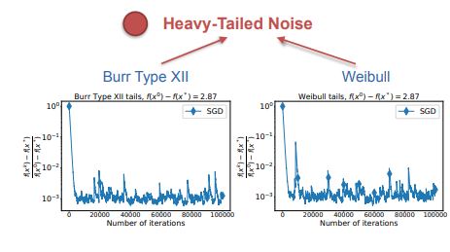
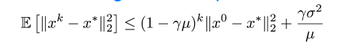
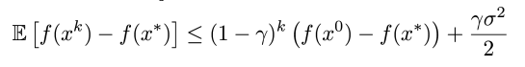
Motivational
Example
By state-of-the-art Theory after k iterations of SGD with step
Convergence in Expectation
Notes:
Чем она отличается от других задач?

Slide 7
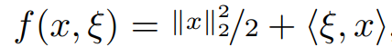
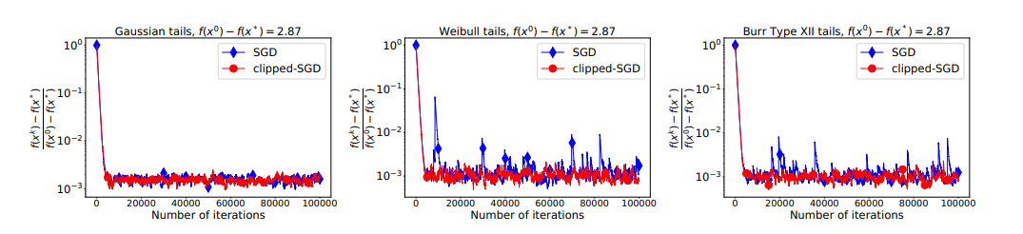
Motivational
Example
Stochastic gradient descent (SGD)
Notes:
Чем она отличается от других задач?

Slide 8
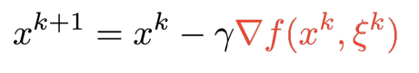
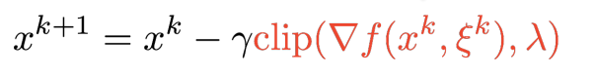
Key Idea
We assume that clipping with clipping lvl lambda is equal to

Slide 9

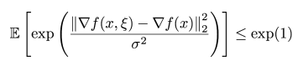
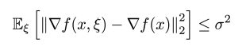
Assumptions
Light-Tails assumptions
Heavy-Tails assumptions
Parameters

Slide 10
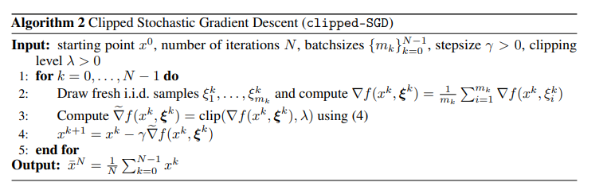
SGD with Clipping

Slide 11
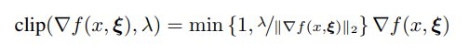
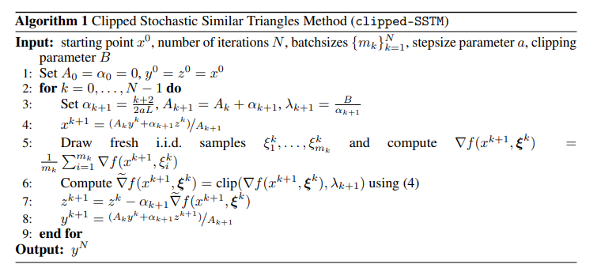
Clipping SSTM
Notes:
Чем она отличается от других задач?

Slide 12
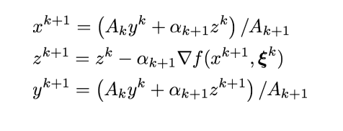
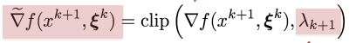
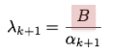
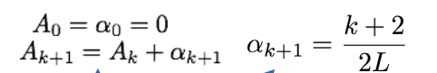
Main Result
Stochastic Similar Triangles Method SSTM

Slide 13
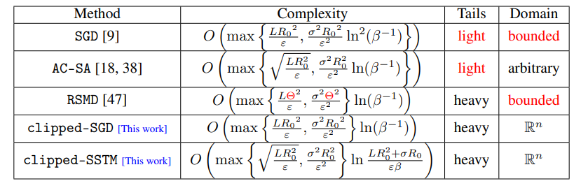
Discussion
Notes:
Чем она отличается от других задач?

Slide 14
Implementation and
Experiments
Implementation of Clipped SSTM and Clipped SGD with PyTorch package
Original paper results reproduction
Experiments on new models and domains: CNNs on images(CIFAR10)

Slide 15
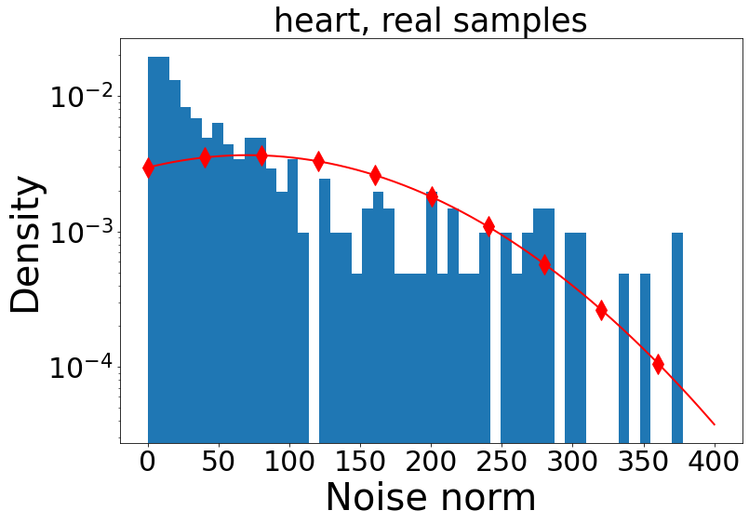
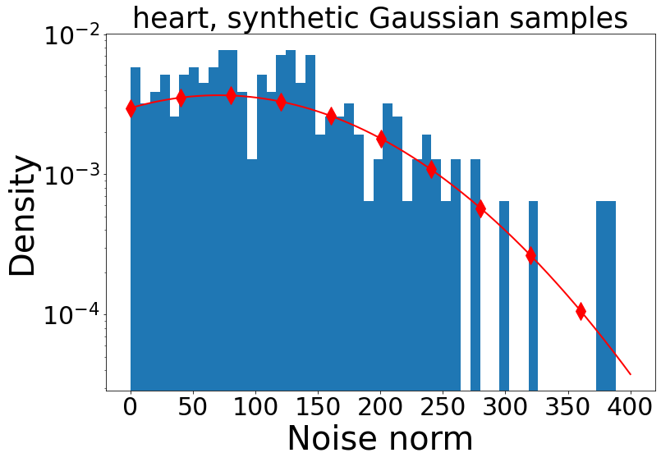
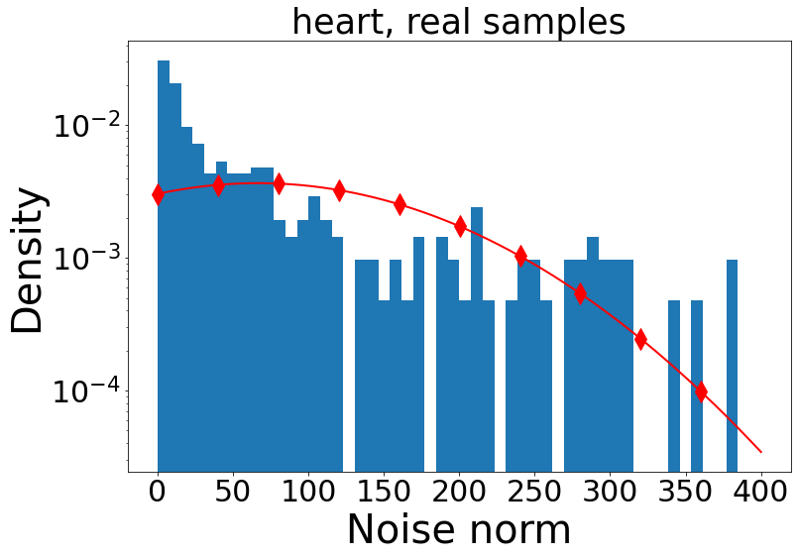
Source paper results reproduction
The original paper experiments and results were reproduced using materials related to the paper’s authors and self-implemented techniques. Obtained results were close and consistent with the results provided in original publication (for example, like on the pictures above).

Slide 16
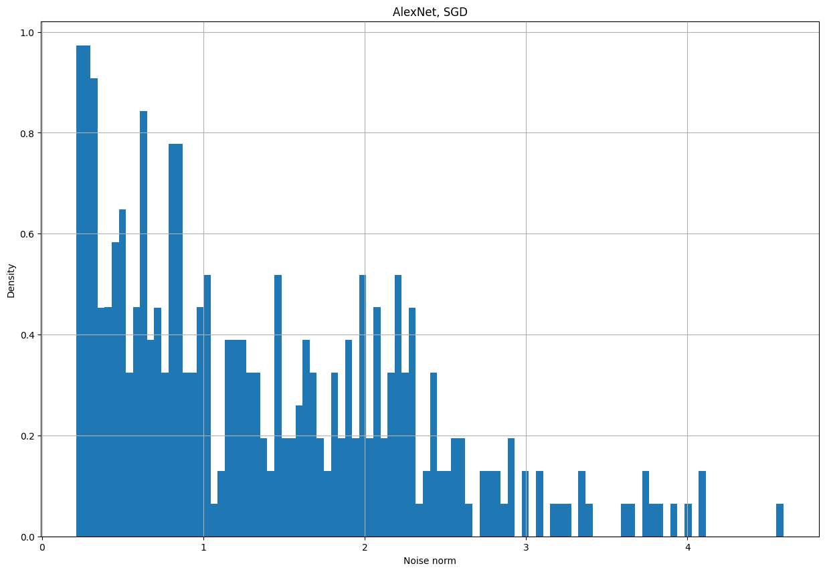
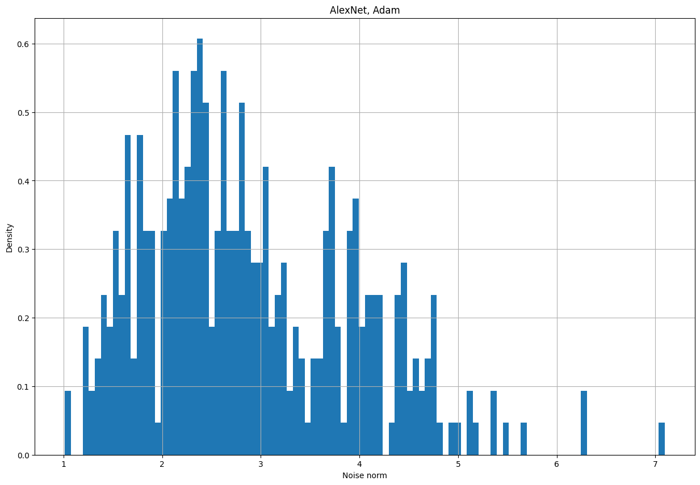
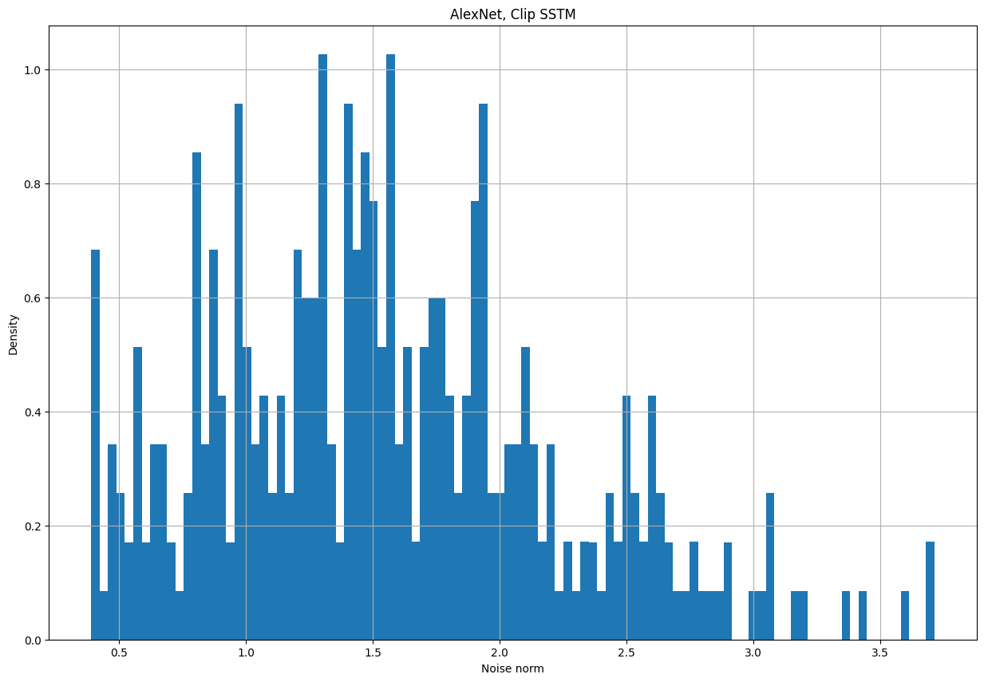
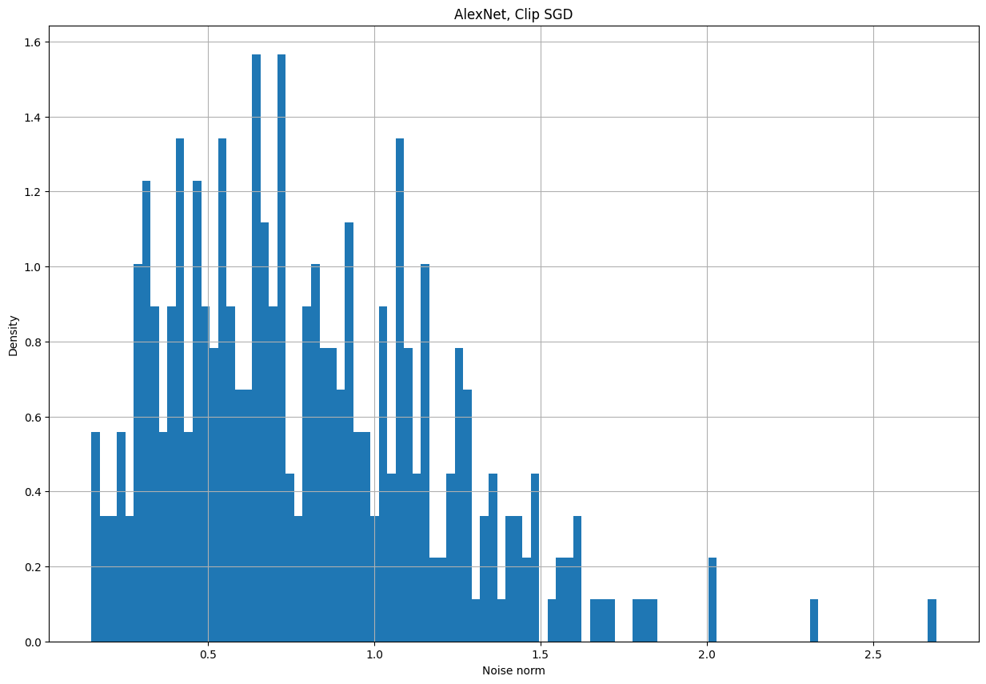
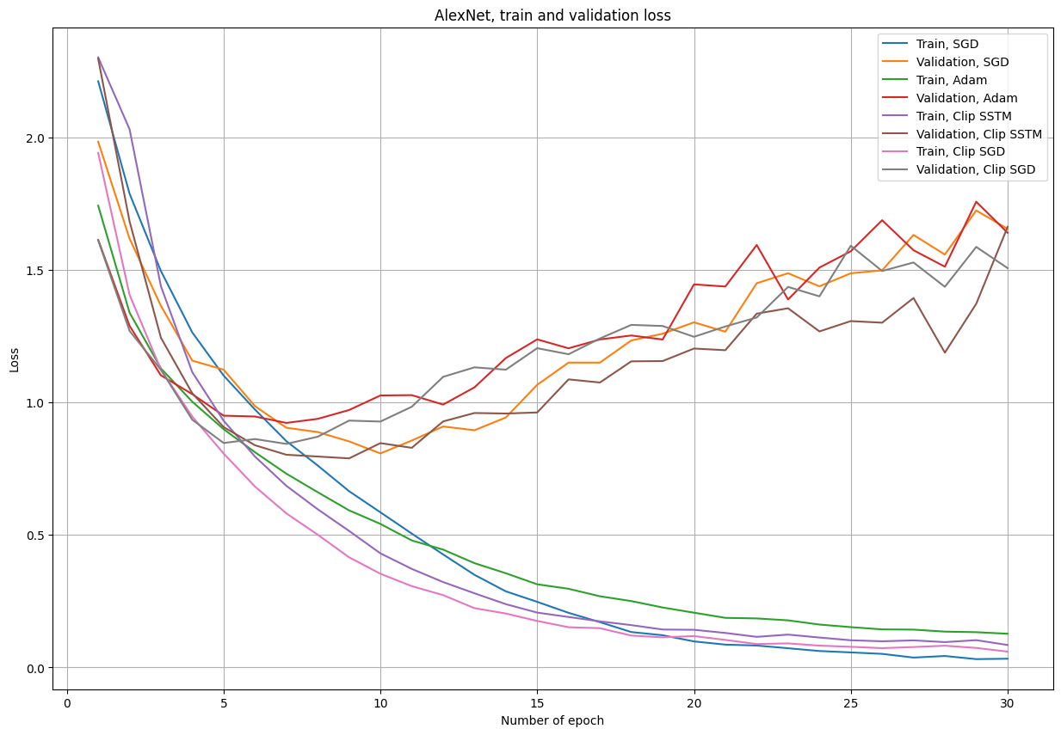
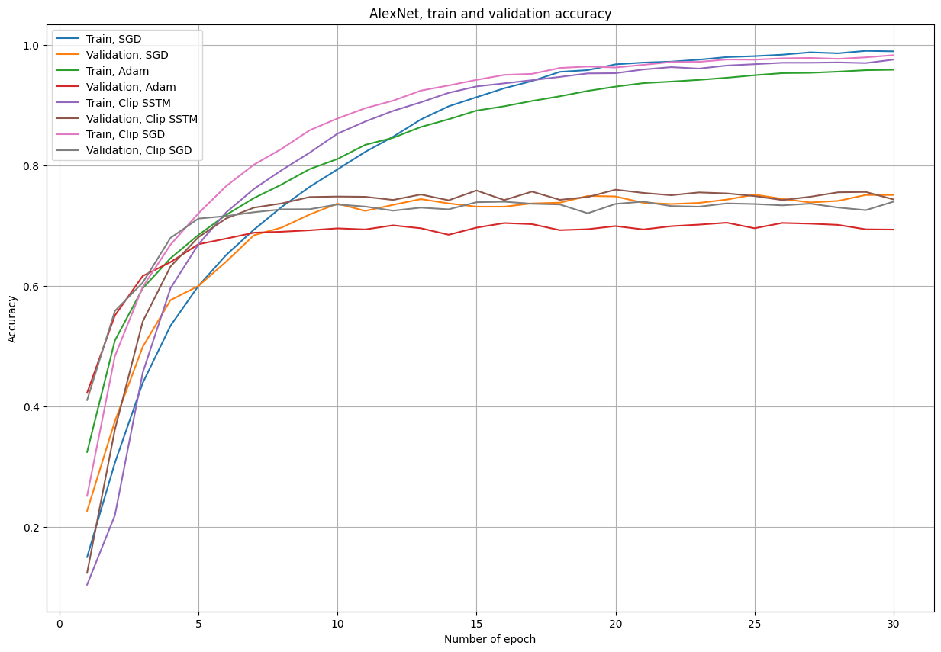
Experiments with CNNs
Considered architectures:
LeNet
AlexNet
VGG of various sizes
ResNet of various sizes
MobileNet
Considered optimizers:
SGD
Adam
Clipped SSTM
Clipped SGD
Notes:
Чем она отличается от других задач?

Slide 17
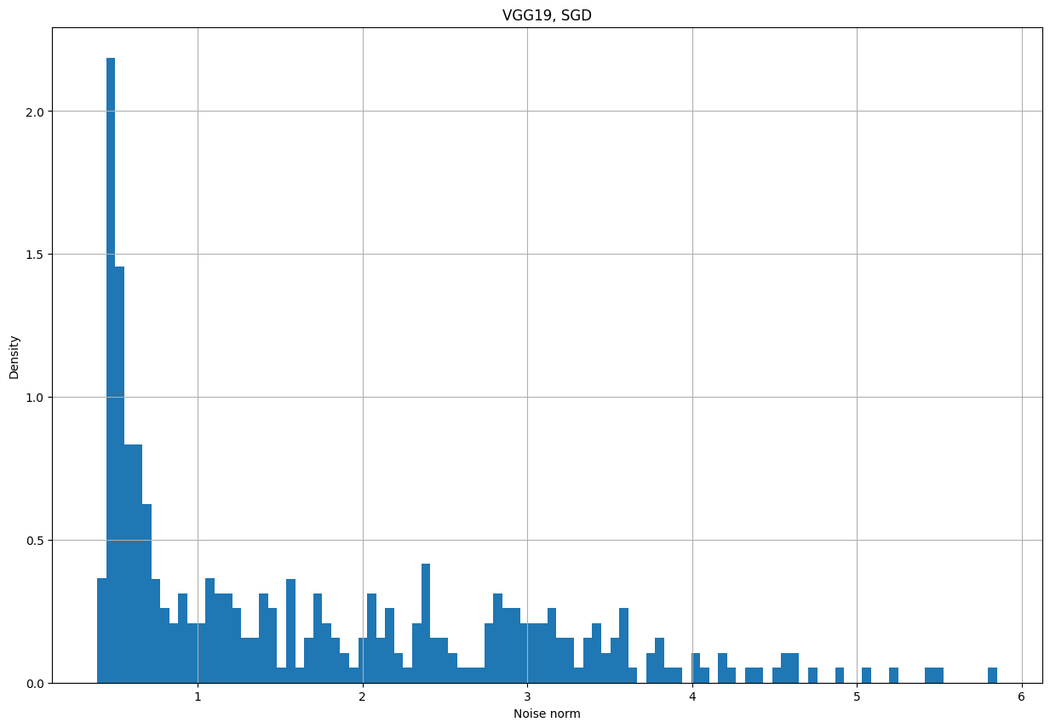
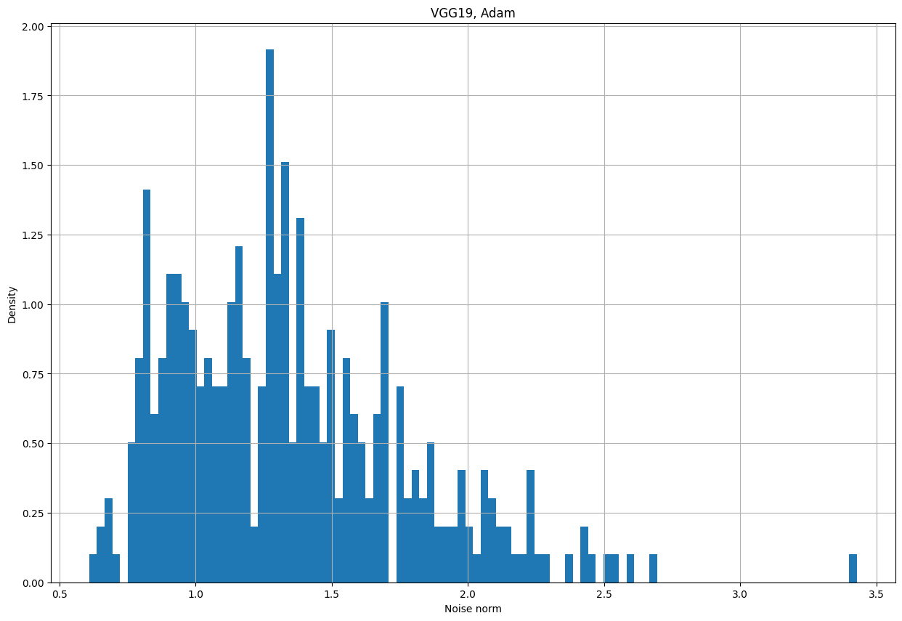
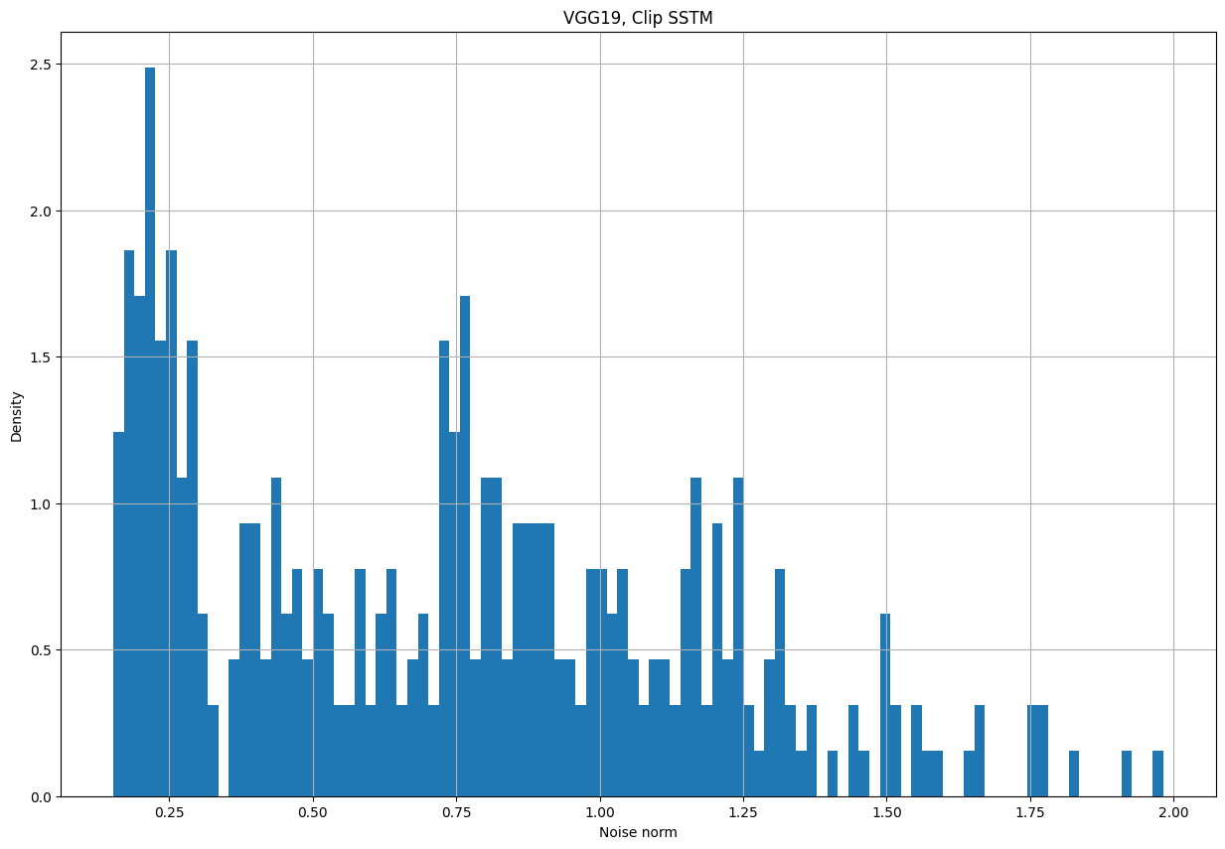
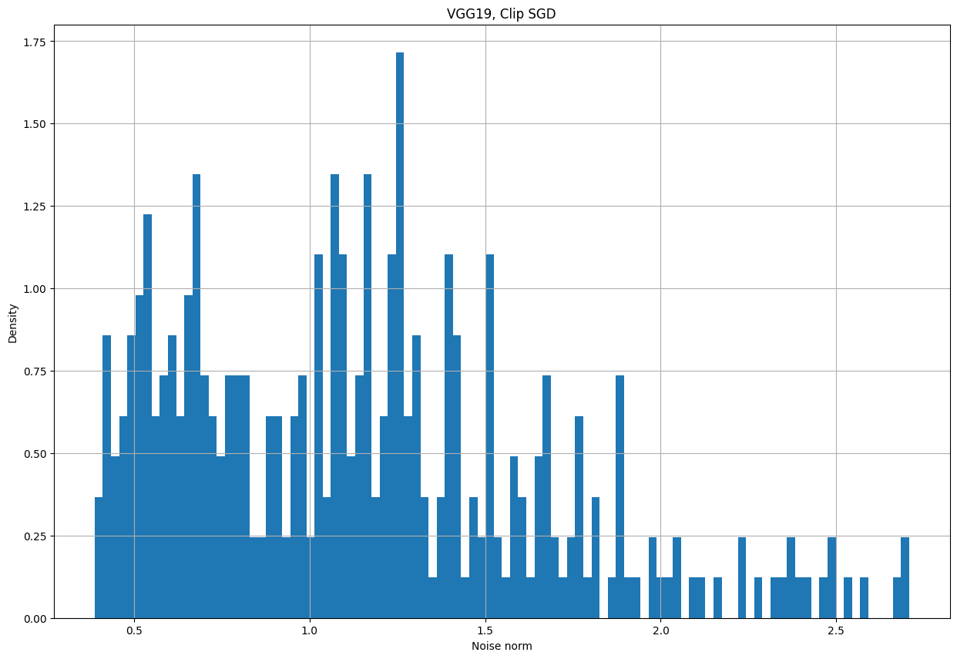
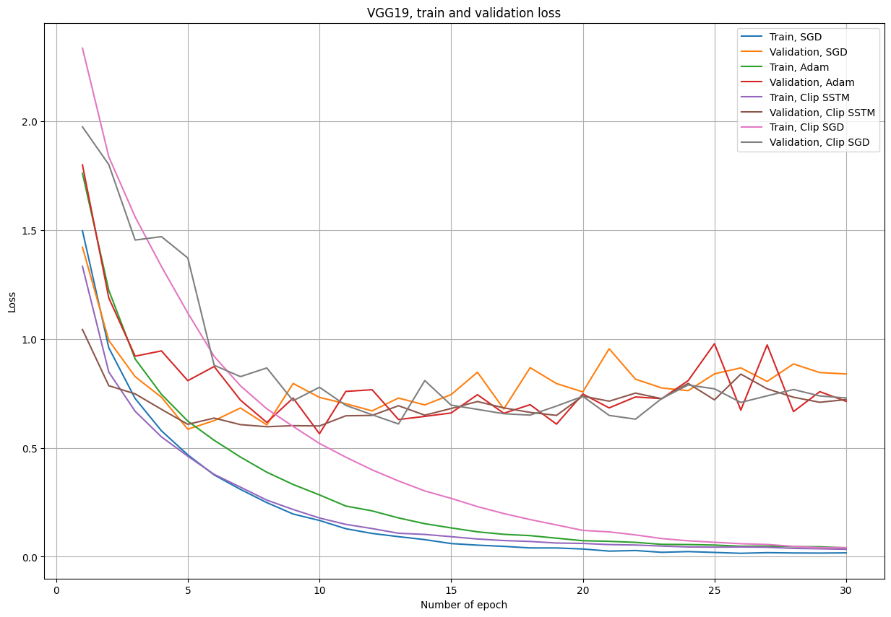
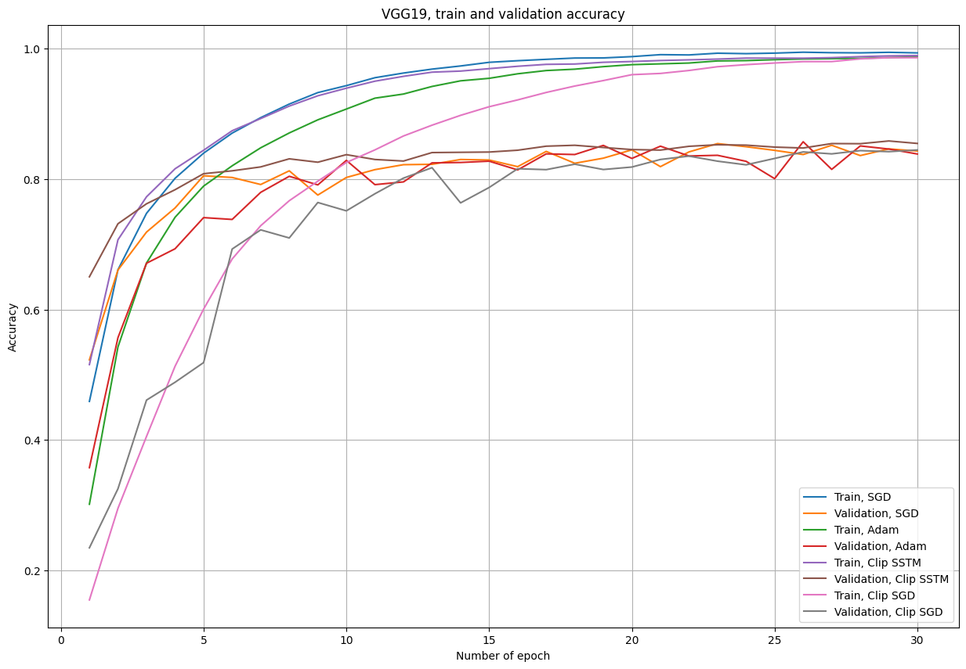
Experiments with CNNs
Notes:
Чем она отличается от других задач?

Slide 18
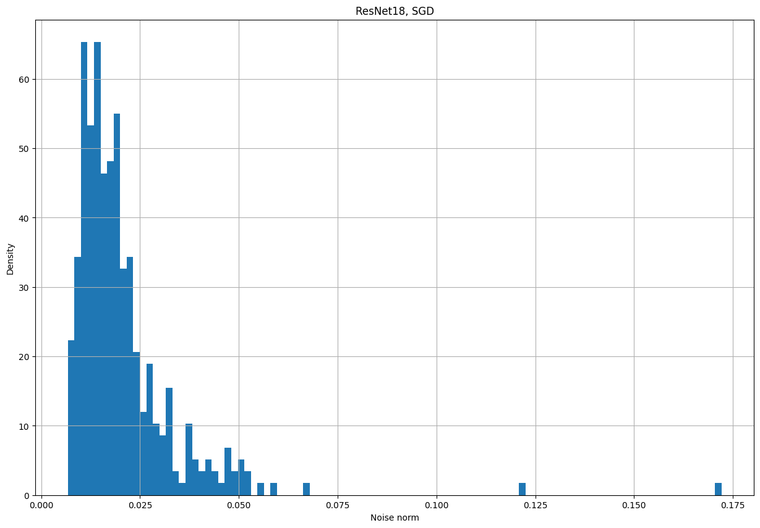
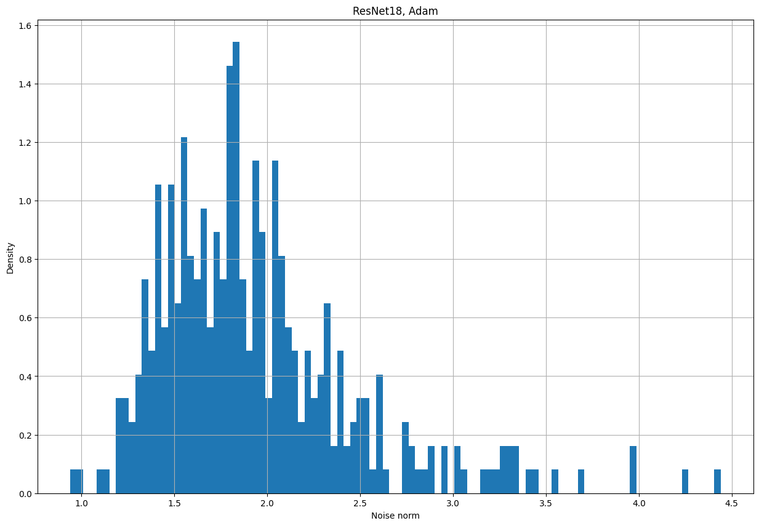
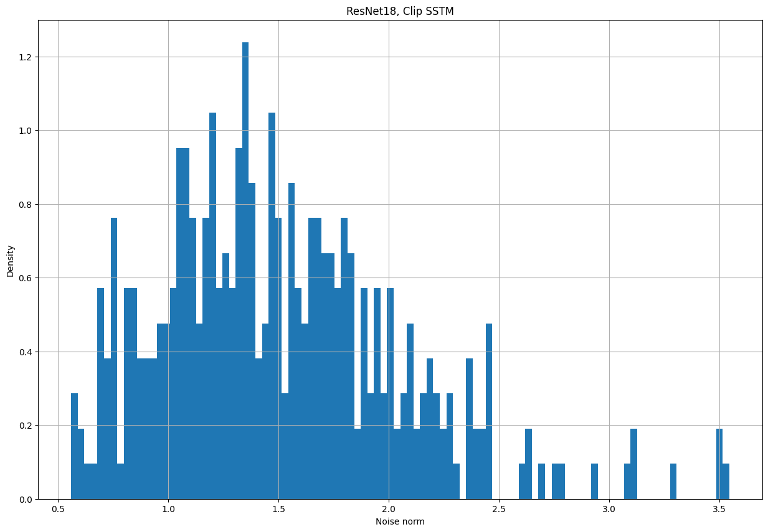
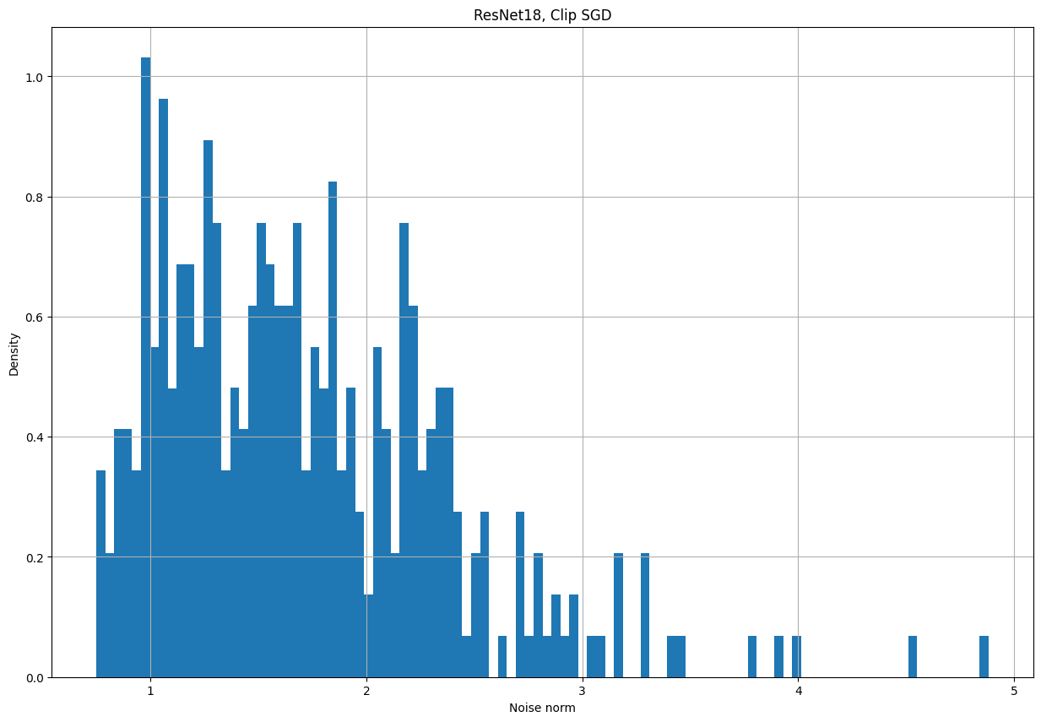
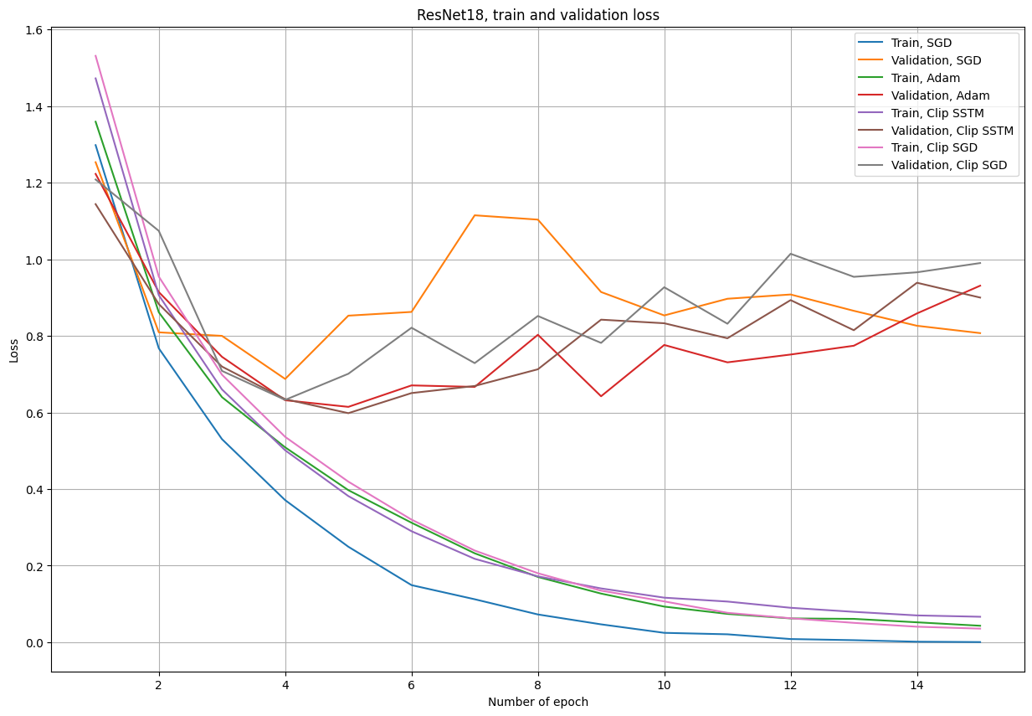
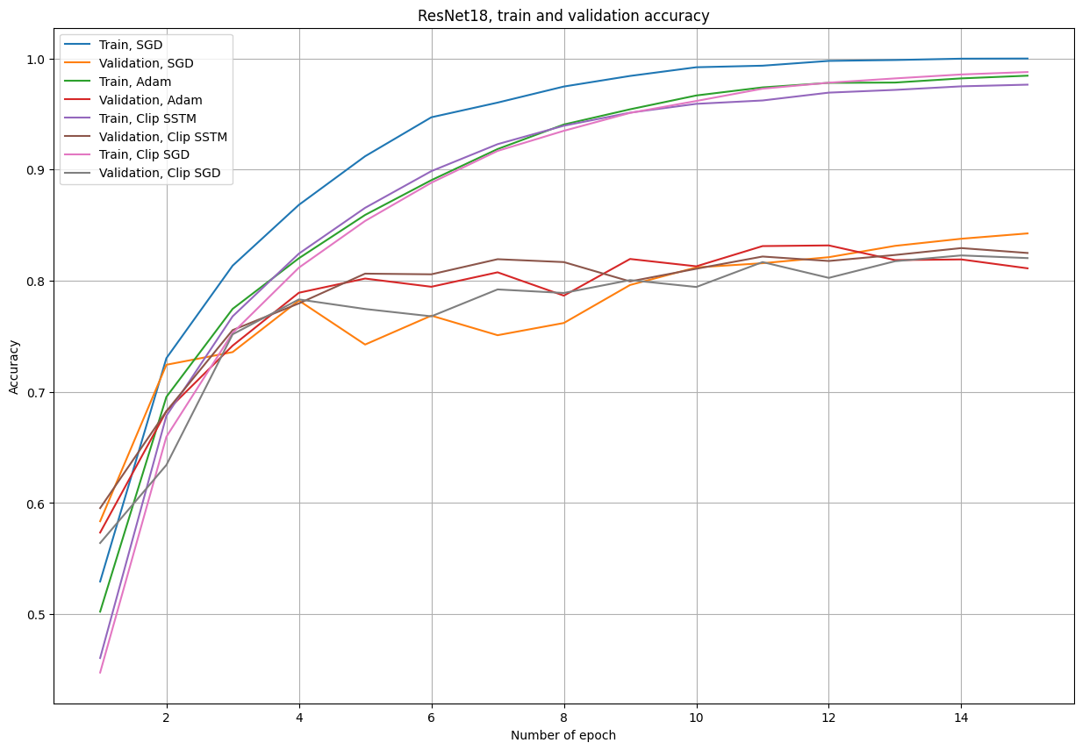
Experiments with CNNs

Slide 19
Key results
Clipped SSTM and Clipped SGD are also applicable and beneficial in domain of convolutional neural networks and images
Clipping technique allows to get more stable gradients in case of absence of light-tails assumption on the noise
Thus, it improves convergence during the optimization in terms of loss values, norms of gradients, final prediction accuracy, etc.

Slide 20
Team Members
Sychev Petr
Boris Mikheev
Our GitHub: https://github.com/ezzbreezn/OptInML-Stochastic-Optimization-with-Heavy-Tailed-Noise-via-Accelerated-Gradient-Clipping

